Slide 1

Machine Learning-Based Metagenomic Analysis of Soil Microbiomes
22BIO201 Intelligence of Biological Systems - 1
Team 7 :​
G Prajwal Priyadarshan - 214​
Kabilan K - 224​
Kishore B - 227
​ Rahul L S - 248​
​

Slide 2
Introduction
Meta Genomics
A metagenome is the entire collection of genetic material (DNA or RNA) obtained directly from an environmental sample (such as soil, water, gut, skin, ocean, etc.) without the need to isolate and culture individual microorganisms.

Slide 3
Meta Genomic Data Analysis
The complete set of genomes present in a microbial community of a given environment.
Source:
Extracted directly from samples like soil, marine water, or the human gut.
Importance:
Helps identify organisms that cannot be cultured in the lab (most microbes are unculturable).
Provides insight into microbial diversity, ecology, and interactions.
Useful in medicine (studying human microbiome), agriculture, biotechnology, and environmental science.

Slide 4
Meta Genomic Data Analysis
To analyze publicly available metagenomic datasets to identify the types of microbes present in a sample and understand their functional roles, using computational tools and AI techniques.
Use publicly available metagenomic data (no lab work needed). Cleans and processes the DNA data using bioinformatics tools.
Find out: Which microbes are present (species identification). What they can do (functional roles).
Can be applied in healthcare, environment, and agriculture.

Slide 5
Problem Statement
Metagenomic datasets contain vast amounts of raw DNA sequences from mixed microbial communities, but this data is often unstructured, noisy, and difficult to interpret.
There is a need for efficient computational methods to clean, classify, and analyze these datasets to identify the diversity of microbes present and understand their functional roles.
Without proper data analytics, valuable biological insights remain hidden, limiting applications in healthcare, environmental monitoring, and agriculture.

Slide 6
Objective
To analyze the Soil Microbe Dataset using metagenomic data analytics.
To study the impact of land use types and soil depth on microbial activity and soil properties.
To build machine learning models for predicting soil health indicators.
To provide insights for sustainable agriculture and land management.

Slide 7
Dataset
Kaggle - Soil Microbe Dataset
📊 General Info
Rows (samples): 100,000
Columns (features): 13
🧹 Data Quality
Missing Values: None (all columns complete).
Data Types: Mostly numerical (int, float), with categorical variables ( Land_Use_Type(string), Soil_Depth_cm ).
Description from Kagle
This synthetic dataset contains 100,000 samples for research and machine learning in soil microbiology, carbon/nitrogen cycling, and sustainable agriculture.
It simulates the effects of land use types and soil depths on microbial activity, enzyme dynamics, and greenhouse gas emissions.

Slide 8
Dataset Features
Feature | Description
ID | Unique identifier for each sample (int)
Soil_pH | Soil acidity/alkalinity level (float)
Organic_C (%) | Organic carbon content percentage (float)
Total_N (%) | Total nitrogen percentage (float)
C_N_Ratio | Carbon-to-Nitrogen ratio (float)
Land_Use_Type | Type of land management (Organic, Traditional, Monoculture)
Soil_Depth_cm | Depth of soil sample (0–10, 10–20 cm)
Bacteria_Abundance (%) | Relative bacterial abundance in soil (float)
Fungi_Abundance (%) | Relative fungal abundance in soil (float)
β_Glucosidase (µmol/g/h) | Soil enzyme activity related to carbon cycling (float)
Urease (µmol/g/h) | Soil enzyme activity related to nitrogen cycling (float)
CO2_Emission (µg/g/day) | Soil respiration/carbon release (float)
NH4_Nitrate (µg/g) | Soil nitrogen availability (float)

Slide 9
Methodology
Metagenomics is the study of genetic material recovered directly from environmental samples without the need to culture individual microorganisms. It allows researchers to analyze the collective genomes of entire microbial communities, providing insights into:
Community composition (Who are the microbes?)
Functional potential (What can they do?)
Ecological interactions (How do they interact?)
Metabolic pathways and biochemical processes
The term was coined by Jo Handelsman in 1998, who defined it as "the cloning and functional analysis of collective genomes of soil microflora".

Slide 10
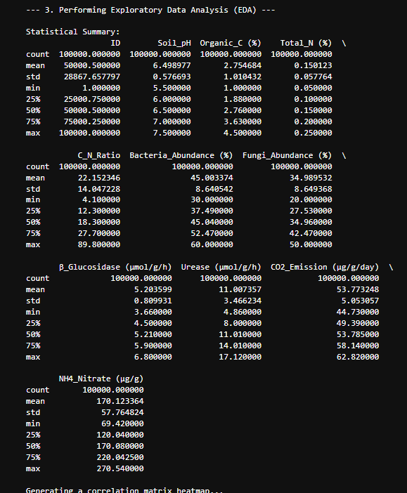
Methodology
Data Processing & Feature Engineering
Data Input: Soil pH, organic carbon, nitrogen, microbial abundance, enzyme activities.
Exploratory Analysis: Visualized distributions, correlations, and trends in soil variables.
Feature Engineering:
Microbe Ratio = Bacteria / Fungi abundance
Enzyme Activity Index = β-Glucosidase + Urease
Preprocessing:
Train-test split (80/20)
Scaling of numerical features
One-hot encoding of categorical features

Slide 11
Machine Learning for CO₂ Emission Prediction
Models Built:
Random Forest Regressor
Linear Regression
Training & Testing: Pipelines applied with preprocessing included.
Evaluation Metrics: R², MAE, MAPE
Results:
Random Forest outperformed Linear Regression
Captured non-linear relationships in soil–microbe–CO₂ interactions
Insights: Feature importance showed microbial and enzyme activity are strong predictors.

Slide 12
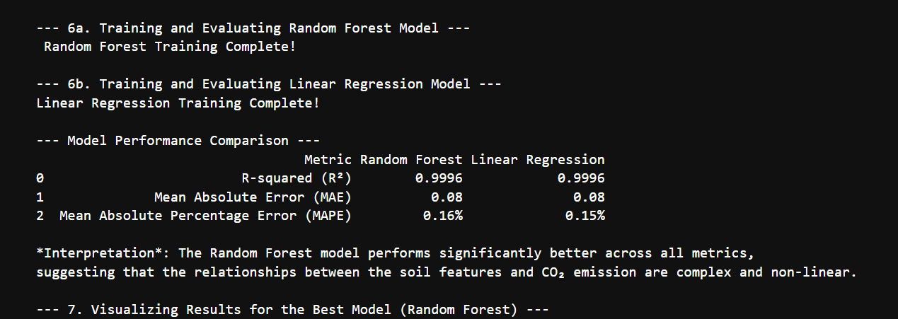
RESULTS

Slide 13
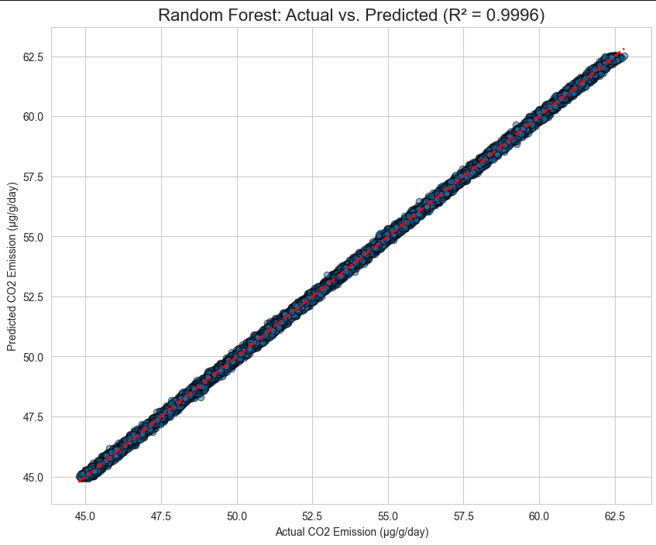
RESULTS

Slide 14
Outcome
Reliable CO₂ Prediction Models: Built and tested Random Forest Regression and Linear Regression to predict CO₂ emission levels.
Performance Evaluation: Compared both models using metrics like R², RMSE, and MAE, showing how well each predicts co2_prediction.
Model Comparison: Random Forest handled non-linear relationships better, while Linear Regression provided a simpler baseline model.
Feature Contribution Analysis: Random Forest feature importance helped identify which microbial/soil factors most strongly influence CO₂ emissions.

Slide 15
Conclusion & Future Work
Key Findings: Random Forest performed better than Linear Regression, proving that CO₂ prediction benefits from models capturing non-linear patterns.
Limitations: Dataset size and feature coverage limit the predictive power—Linear Regression oversimplified the relationships.
Future Improvements: Extend to classification tasks (e.g., grouping soil samples into “High vs. Low CO₂ emitters”), apply advanced models (XGBoost, Gradient Boosting, Neural Networks), and perform hyperparameter tuning.
Real-World Relevance: Results can support climate change studies, carbon cycle monitoring, and soil management practices by predicting and classifying CO₂ emission patterns more accurately.

Slide 16
Thank You !

